Slide 1
Naive Bayes Algorithm and Support Vector Machine

Slide 2
Naïve Bayes Classifier Algorithm
Naïve Bayes algorithm is a supervised learning algorithm, which is based on Bayes theorem and used for solving classification problems.
It is mainly used in text classification that includes a high-dimensional training dataset.
Naïve Bayes Classifier is one of the simple and most effective Classification algorithms which helps in building the fast machine learning models that can make quick predictions.
It is a probabilistic classifier, which means it predicts on the basis of the probability of an object.
Some popular examples of Naïve Bayes Algorithm are spam filtration, Sentimental analysis, and classifying articles.

Slide 3
Why is it called Naïve Bayes?
The Naïve Bayes algorithm is comprised of two words Naïve and Bayes, Which can be described as:
Naïve:
It is called Naïve because it assumes that the occurrence of a certain feature is independent of the occurrence of other features.
Such as if the fruit is identified on the bases of color, shape, and taste, then red, spherical, and sweet fruit is recognized as an apple.
Hence each feature individually contributes to identify that it is an apple without depending on each other.
Bayes: It is called Bayes because it depends on the principle of Bayes' Theorem

Slide 4
Bayes' Theorem:
Bayes' theorem is also known as Bayes' Rule or Bayes' law, which is used to determine the probability of a hypothesis with prior knowledge. It depends on the conditional probability.
The formula for Bayes' theorem is:
Naïve Bayes Classifier Algorithm
Where,
P(A|B) is Posterior probability: Probability of hypothesis A on the observed event B.
P(B|A) is Likelihood probability: Probability of the evidence given that the probability of a hypothesis is true.
P(A) is Prior Probability: Probability of hypothesis before observing the evidence.
P(B) is Marginal Probability: Probability of Evidence.

Slide 5
Working of Naïve Bayes' Classifier:
Working of Naïve Bayes' Classifier can be understood with the help of the below example:
Suppose we have a dataset of weather conditions and corresponding target variable "Play".
So using this dataset we need to decide that whether we should play or not on a particular day according to the weather conditions.
So to solve this problem, we need to follow:
Convert the given dataset into frequency tables.
Generate Likelihood table by finding the probabilities of given features.
Now, use Bayes theorem to calculate the posterior probability.
Problem: If the weather is sunny, then the Player should play or not?
Solution: To solve this, first consider the below dataset:

Slide 6
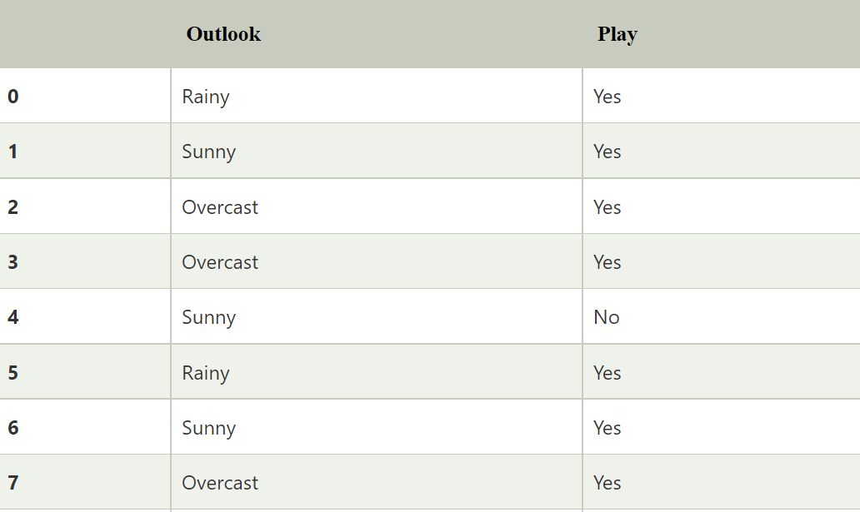

Slide 7
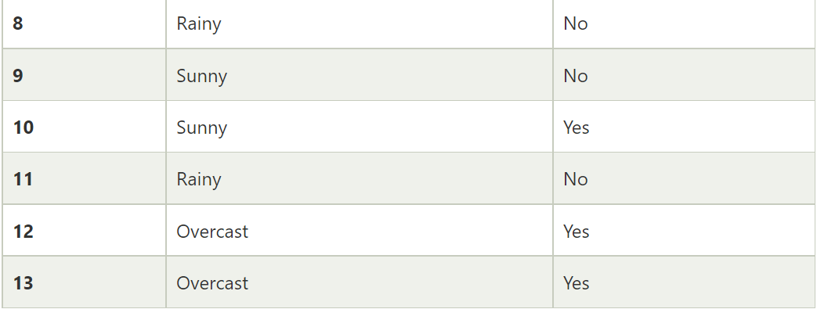

Slide 8
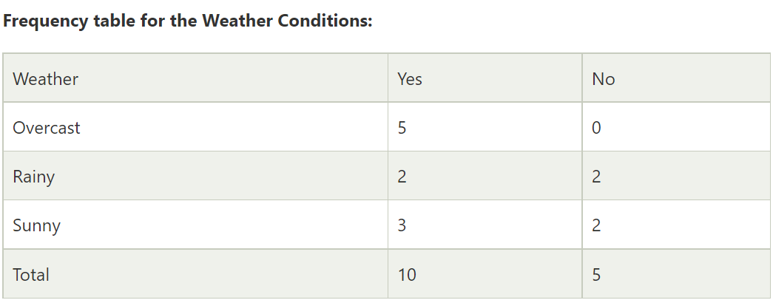

Slide 9
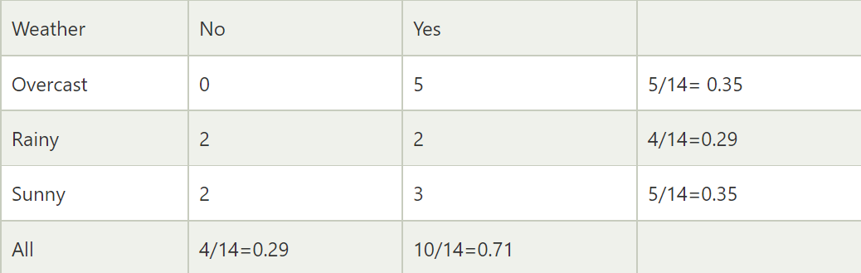
Likelihood table weather condition:

Slide 10
Applying Bayes'theorem:
P(Yes|Sunny)= P(Sunny|Yes)*P(Yes)/P(Sunny)
P(Sunny|Yes)= 3/10= 0.3
P(Sunny)= 0.35
P(Yes)=0.71
So P(Yes|Sunny) = 0.3*0.71/0.35= 0.60
P(No|Sunny)= P(Sunny|No)*P(No)/P(Sunny)
P(Sunny|NO)= 2/4=0.5

Slide 11
P(No)= 0.29
P(Sunny)= 0.35
So P(No|Sunny)= 0.5*0.29/0.35 = 0.41
So as we can see from the above calculation that P(Yes|Sunny)>P(No|Sunny)
Hence on a Sunny day, Player can play the game.

Slide 12
Advantages of Naïve Bayes Classifier:
Naïve Bayes is one of the fast and easy ML algorithms to predict a class of datasets.
It can be used for Binary as well as Multi-class Classifications.
It performs well in Multi-class predictions as compared to the other Algorithms.
It is the most popular choice for text classification problems.
Disadvantages of Naïve Bayes Classifier:
Naive Bayes assumes that all features are independent or unrelated, so it cannot learn the relationship between features.
Applications of Naïve Bayes Classifier:
It is used for Credit Scoring.
It is used in medical data classification.
It can be used in real-time predictions because Naïve Bayes Classifier is an eager learner.
It is used in Text classification such as Spam filtering and Sentiment analysis.

Slide 13
Python Implementation of the Naïve Bayes algorithm:
Steps to implement:
Data Pre-processing step
Fitting Naive Bayes to the Training set
Predicting the test result
Test accuracy of the result(Creation of Confusion matrix)
Visualizing the test set result.

Slide 14
Data Pre-processing step:
In this step, we will pre-process/prepare the data so that we can use it efficiently in our code. It is similar as we did in data-pre-processing
importing the libraries
import numpy as nm
import matplotlib.pyplot as mtp
import pandas as pd
dataset = pd.read_csv('user_data.csv')
x = dataset.iloc[:, [2, 3]].values
y = dataset.iloc[:, 4].values
from sklearn.model_selection import train_test_split
x_train, x_test, y_train, y_test = train_test_split(x, y, test_size = 0.25, random_state = 0)
from sklearn.preprocessing import StandardScaler
sc = StandardScaler()
x_train = sc.fit_transform(x_train)
x_test = sc.transform(x_test)

Slide 15
We have loaded the dataset into our program using "dataset = pd.read_csv('user_data.csv'). The loaded dataset is divided into training and test set, and then we have scaled the feature variable.
Fitting Naive Bayes to the Training Set:
After the pre-processing step, now we will fit the Naive Bayes model to the Training set. Below is the code for it:
from sklearn.naive_bayes import GaussianNB
classifier = GaussianNB()
classifier.fit(x_train, y_train)
we have used the GaussianNB classifier to fit it to the training dataset. We can also use other classifiers as per our requirement.

Slide 16
Prediction of the test set result:
Now we will predict the test set result. For this, we will create a new predictor variable y_pred, and will use the predict function to make the predictions.
y_pred = classifier.predict(x_test)
The above output shows the result for prediction vector y_pred and real vector y_test. We can see that some predications are different from the real values, which are the incorrect predictions.
Creating Confusion Matrix:
Now we will check the accuracy of the Naive Bayes classifier using the Confusion matrix.
from sklearn.metrics import confusion_matrix
cm = confusion_matrix(y_test, y_pred)

Slide 17
Visualizing the training set result:
Next we will visualize the training set result using Naïve Bayes Classifier.
from matplotlib.colors import ListedColormap
x_set, y_set = x_train, y_train
X1, X2 = nm.meshgrid(nm.arange(start = x_set[:, 0].min() - 1, stop = x_set[:, 0].max() + 1, step = 0.01),
nm.arange(start = x_set[:, 1].min() - 1, stop = x_set[:, 1].max() + 1, step = 0.01))
mtp.contourf(X1, X2, classifier.predict(nm.array([X1.ravel(), X2.ravel()]).T).reshape(X1.shape),
alpha = 0.75, cmap = ListedColormap(('purple', 'green')))
mtp.xlim(X1.min(), X1.max())
mtp.ylim(X2.min(), X2.max())

Slide 18
for i, j in enumerate(nm.unique(y_set)):
mtp.scatter(x_set[y_set == j, 0], x_set[y_set == j, 1],
c = ListedColormap(('purple', 'green'))(i), label = j)
mtp.title('Naive Bayes (Training set)')
mtp.xlabel('Age')
mtp.ylabel('Estimated Salary')
mtp.legend()
mtp.show()

Slide 19
l1 = ["eat", "sleep", "repeat"]
s1 = "good"
obj1 = enumerate(l1)
obj2 = enumerate(s1)
print ("Return type:", type(obj1))
print (list(enumerate(l1)))
print (list(enumerate(s1, 2)))

Slide 20
Support vector machine algorithm
Support Vector Machine or SVM is one of the most popular Supervised Learning algorithms, which is used for Classification as well as Regression problems.
However, primarily, it is used for Classification problems in Machine Learning.
The goal of the SVM algorithm is to create the best line or decision boundary that can segregate n-dimensional space into classes so that we can easily put the new data point in the correct category in the future.
This best decision boundary is called a hyperplane.
SVM chooses the extreme points/vectors that help in creating the hyperplane.
These extreme cases are called as support vectors, and hence algorithm is termed as Support Vector Machine.

Slide 21


Slide 22
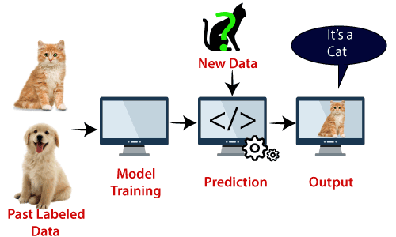
Example:
SVM can be understood with the example that we have used in the KNN classifier.
Suppose we see a strange cat that also has some features of dogs, so if we want a model that can accurately identify whether it is a cat or dog, so such a model can be created by using the SVM algorithm.
We will first train our model with lots of images of cats and dogs so that it can learn about different features of cats and dogs, and then we test it with this strange creature.
So as support vector creates a decision boundary between these two data (cat and dog) and choose extreme cases (support vectors), it will see the extreme case of cat and dog.

Slide 23
SVM algorithm can be used for Face detection, image classification, text categorization, etc.
Types of SVM
SVM can be of two types:
Linear SVM:
Linear SVM is used for linearly separable data, which means if a dataset can be classified into two classes by using a single straight line, then such data is termed as linearly separable data, and classifier is used called as Linear SVM classifier.
Non-linear SVM:
Non-Linear SVM is used for non-linearly separated data, which means if a dataset cannot be classified by using a straight line, then such data is termed as non-linear data and classifier used is called as Non-linear SVM classifier.

Slide 24
Hyperplane and Support Vectors in the SVM algorithm:
Hyperplane:
There can be multiple lines/decision boundaries to segregate the classes in n-dimensional space, but we need to find out the best decision boundary that helps to classify the data points.
This best boundary is known as the hyperplane of SVM.
The dimensions of the hyperplane depend on the features present in the dataset, which means if there are 2 features then hyperplane will be a straight line.
And if there are 3 features, then hyperplane will be a 2-dimension plane.
We always create a hyperplane that has a maximum margin, which means the maximum distance between the data points.

Slide 25
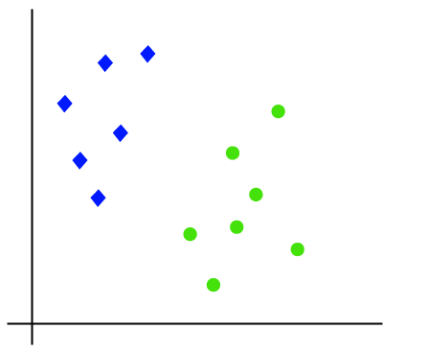
Support Vectors:
The data points or vectors that are the closest to the hyperplane and which affect the position of the hyperplane are termed as Support Vector. Since these vectors support the hyperplane, hence called a Support vector.
How does SVM works?
The working of the SVM algorithm can be understood by using an example.
Suppose we have a dataset that has two tags (green and blue), and the dataset has two features x1 and x2.
We want a classifier that can classify the pair(x1, x2) of coordinates in either green or blue.

Slide 26
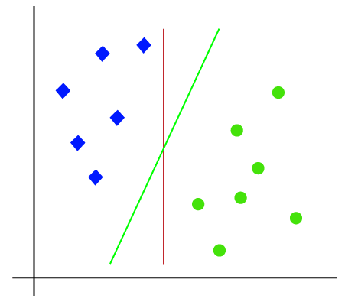
So as it is 2-d space so by just using a straight line, we can easily separate these two classes. But there can be multiple lines that can separate these classes.

Slide 27
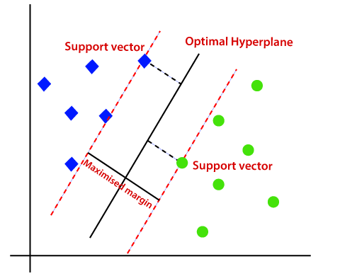
Hence, the SVM algorithm helps to find the best line or decision boundary; this best boundary or region is called as a hyperplane.
SVM algorithm finds the closest point of the lines from both the classes.
These points are called support vectors.
The distance between the vectors and the hyperplane is called as margin.
And the goal of SVM is to maximize this margin. The hyperplane with maximum margin is called the optimal hyperplane.

Slide 28
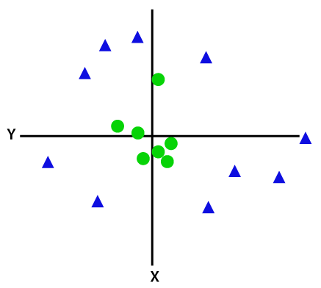
Non-Linear SVM:
If data is linearly arranged, then we can separate it by using a straight line, but for non-linear data, we cannot draw a single straight line.

Slide 29
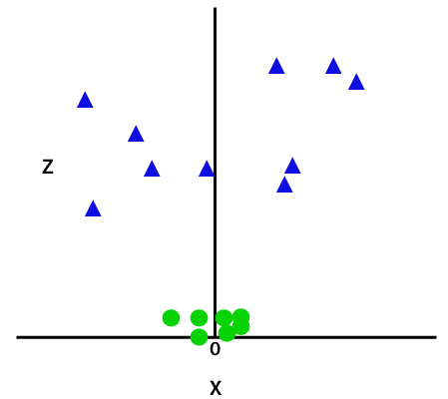
So to separate these data points, we need to add one more dimension. For linear data, we have used two dimensions x and y, so for non-linear data, we will add a third dimension z. It can be calculated as:
z=x(exp)2 +y2(exp)2

Slide 30
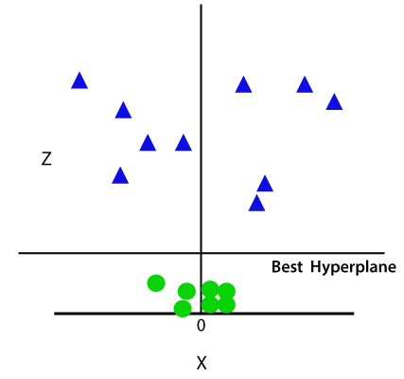
So now, SVM will divide the datasets into classes in the following way.

Slide 31
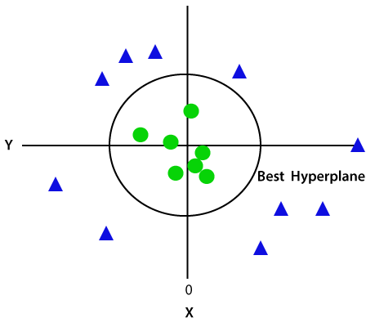
Since we are in 3-d Space, hence it is looking like a plane parallel to the x-axis. If we convert it in 2d space with z=1, then it will become as:

Slide 32
Python Implementation of Support Vector Machine
Now we will implement the SVM algorithm using Python. Here we will use the same dataset user_data, which we have used in Logistic regression and KNN classification.
Data Pre-processing step
Till the Data pre-processing step, the code will remain the same.
import numpy as nm
import matplotlib.pyplot as mtp
import pandas as pd
data_set= pd.read_csv(‘Medals.csv')
x= data_set.iloc[:, [2,6]].values
y= data_set.iloc[:, 6].values
from sklearn.model_selection import train_test_split
x_train, x_test, y_train, y_test= train_test_split(x, y, test_size= 0.25, random_state=0)

Slide 33
from sklearn.preprocessing import StandardScaler
st_x= StandardScaler()
x_train= st_x.fit_transform(x_train)
x_test= st_x.transform(x_test)
Fitting the SVM classifier to the training set:
Now the training set will be fitted to the SVM classifier. To create the SVM classifier, we will import SVC class from Sklearn.svm library.
from sklearn.svm import SVC classifier = SVC(kernel='linear', random_state=0)
classifier.fit(x_train, y_train)
We have used kernel='linear', as here we are creating SVM for linearly separable data.
However, we can change it for non-linear data.
And then we fitted the classifier to the training dataset(x_train, y_train)

Slide 34
Predicting the test set result:
Now, we will predict the output for test set. For this, we will create a new vector y_pred.
y_pred= classifier.predict(x_test)
Creating the confusion matrix:
Now we will see the performance of the SVM classifier that how many incorrect predictions are there as compared to the Logistic regression classifier.
To create the confusion matrix, we need to import the confusion_matrix function of the sklearn library. After importing the function, we will call it using a new variable cm.
The function takes two parameters, mainly y_true( the actual values) and y_pred (the targeted value return by the classifier).
from sklearn.metrics import confusion_matrix
cm= confusion_matrix(y_test, y_pred)

Slide 35
Visualizing the training set result:
Now we will visualize the training set result, below is the code for it:
from matplotlib.colors import ListedColormap
x_set, y_set = x_train, y_train
x1, x2 = nm.meshgrid(nm.arange(start = x_set[:, 0].min() - 1, stop = x_set[:, 0].max() + 1, step =0.01),
nm.arange(start = x_set[:, 1].min() - 1, stop = x_set[:, 1].max() + 1, step = 0.01))
mtp.contourf(x1, x2, classifier.predict(nm.array([x1.ravel(), x2.ravel()]).T).reshape(x1.shape),
alpha = 0.75, cmap = ListedColormap(('red', 'green')))
mtp.xlim(x1.min(), x1.max())
mtp.ylim(x2.min(), x2.max())
for i, j in enumerate(nm.unique(y_set)):
mtp.scatter(x_set[y_set == j, 0], x_set[y_set == j, 1],
c = ListedColormap(('red', 'green'))(i), label = j)

Slide 36
mtp.title('SVM classifier (Training set)')
mtp.xlabel(‘Gold')
mtp.ylabel(‘Rank by Total')
mtp.legend()
mtp.show()

Slide 37
Visualizing the test set result:
from matplotlib.colors import ListedColormap
x_set, y_set = x_test, y_test
x1, x2 = nm.meshgrid(nm.arange(start = x_set[:, 0].min() - 1, stop = x_set[:, 0].max() + 1, step =0.01),
nm.arange(start = x_set[:, 1].min() - 1, stop = x_set[:, 1].max() + 1, step = 0.01))
mtp.contourf(x1, x2, classifier.predict(nm.array([x1.ravel(), x2.ravel()]).T).reshape(x1.shape),
alpha = 0.75, cmap = ListedColormap(('red','green' )))
mtp.xlim(x1.min(), x1.max())
mtp.ylim(x2.min(), x2.max())

Slide 38
for i, j in enumerate(nm.unique(y_set)):
mtp.scatter(x_set[y_set == j, 0], x_set[y_set == j, 1],
c = ListedColormap(('red', 'green'))(i), label = j)
mtp.title('SVM classifier (Test set)')
mtp.xlabel(‘Gold')
mtp.ylabel(‘Rank by Total’)
mtp.legend()
mtp.show()

